Slide 1
Python
List

Slide 2
List
Lists are used to store multiple items in a single variable.
List is heterogenous (mixed data can stored)
List items are ordered, changeable, and allow duplicate values.
List is indexed(item have indexes and can be sliced)

Slide 3
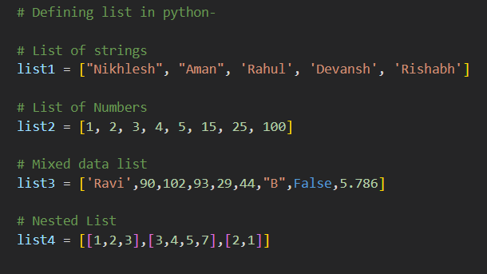
Create a list in Python
List can be created by the uses of [] brackets with values inside it separated with commas

Slide 4
Indexing in List
We can access individual items of list using indexing
Python allows negative indexing for its sequences.
Negative index
-9
-8
-7
-6
-5
-4
-3
-2
-1
2
4
6
‘A’
10
‘B’
16
‘C’
20
Positive index
0
1
2
3
4
5
6
7
8
Trying to access a character out of index range will raise an IndexError. The index must be an integer.

Slide 5
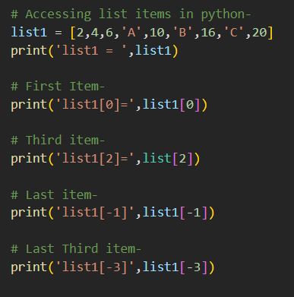
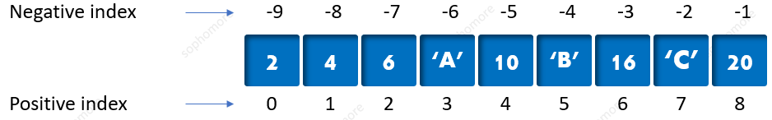
Indexing in List
List1 =
2
x[0]
‘A’
x[3]
20
x[-1]

Slide 6
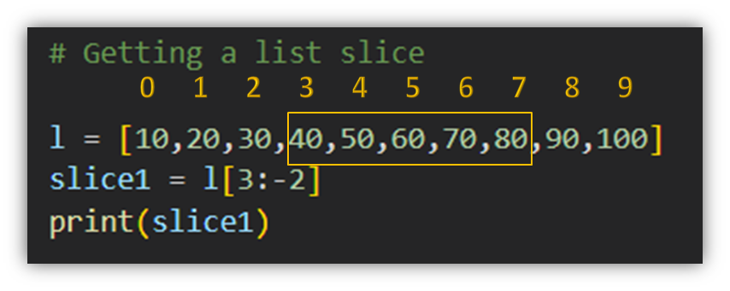
List Slicing
Python also allows a form of indexing syntax that extracts sub-list from a list, known as list Slicing.
If l is a list, an expression of the form l[ m : n ] returns the portion of l starting with position m, and up to but not including position n

Slide 7
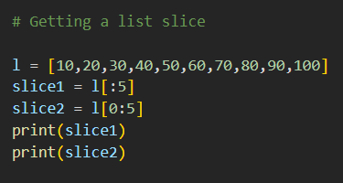
List Slicing
If you omit the first index, the slice starts at the beginning of the list. Thus, l[:m] and l[0:m] are equivalent

Slide 8
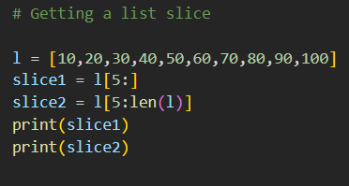
List Slicing
Similarly, if you omit the second index as in l[ n : ], the slice extends from the first index through the end of the string. This is a nice, concise alternative to the more cumbersome l[ n : len(l) ]

Slide 9
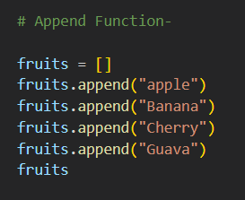
Built-in function for List
These are python functions that are used directly on list for specific output. Below are some important functions
Try it yourself
append( )–Adds an item in the list.
insert( ) – Adds an item at the specified position.
extend( )– Add 2 lists.
sort( )– Sort the list
remove() - Removes the item with the specified value.
reverse()- Reverses the order of the list

Slide 10
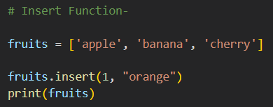
Built-in function for List
These are python functions that are used directly on list for specific output. Below are some important functions
Try it yourself
append( )–Adds an item in the list.
insert( ) – Adds an item at the specified position.
extend( )– Add 2 lists.
sort( )– Sort the list
remove() - Removes the item with the specified value.
reverse()- Reverses the order of the list

Slide 11
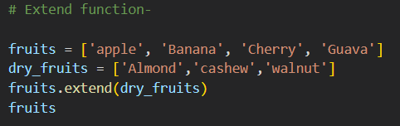
Built-in function for List
These are python functions that are used directly on list for specific output. Below are some important functions
Try it yourself
append( )–Adds an item in the list.
insert( ) – Adds an item at the specified position.
extend( )– Add 2 lists.
sort( )– Sort the list
remove() - Removes the item with the specified value.
reverse()- Reverses the order of the list

Slide 12
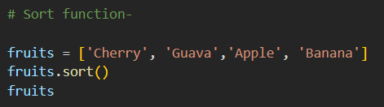
Built-in function for List
These are python functions that are used directly on list for specific output. Below are some important functions
Try it yourself
append( )–Adds an item in the list.
insert( ) – Adds an item at the specified position.
extend( )– Add 2 lists.
sort( )– Sort the list
remove() - Removes the item with the specified value.
reverse()- Reverses the order of the list

Slide 13
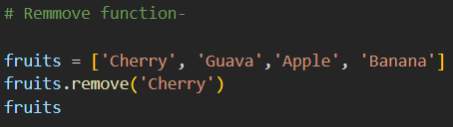
Built-in function for List
These are python functions that are used directly on list for specific output. Below are some important functions
Try it yourself
append( )–Adds an item in the list.
insert( ) – Adds an item at the specified position.
extend( )– Add 2 lists.
sort( ) – Sort the list
remove() - Removes the item with the specified value.
reverse()- Reverses the order of the list

Slide 14
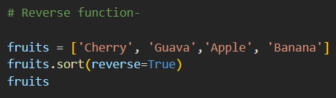
Built-in function for List
These are python functions that are used directly on list for specific output. Below are some important functions
Try it yourself
append( )–Adds an item in the list.
insert( ) – Adds an item at the specified position.
extend( )– Add 2 lists.
sort( ) – Sort the list
remove() - Removes the item with the specified value.
reverse()- Reverses the order of the list

Slide 15
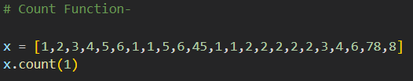
Built-in function for List
These are python functions that are used directly on list for specific output. Below are some important functions
Try it yourself
count( )–Returns the number of items with the specified value.
index( )–Returns the index of the first element with the specified value
copy( )– Returns a copy of the list
clear( ) – Removes all the elements from the list
pop() -Removes the element at the specified position

Slide 16
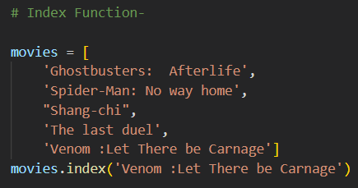
Built-in function for List
These are python functions that are used directly on list for specific output. Below are some important functions
Try it yourself
count( )–Returns the number of items with the specified value.
index( )–Returns the index of the first element with the specified value
copy( )– Returns a copy of the list
clear( ) – Removes all the elements from the list
pop() -Removes the element at the specified position

Slide 17
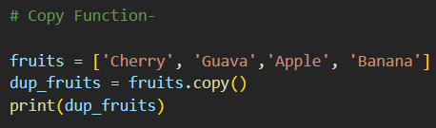
Built-in function for List
These are python functions that are used directly on list for specific output. Below are some important functions
Try it yourself
count( )–Returns the number of items with the specified value.
index( )–Returns the index of the first element with the specified value
copy( )– Returns a copy of the list
clear( ) – Removes all the elements from the list
pop() -Removes the element at the specified position

Slide 18
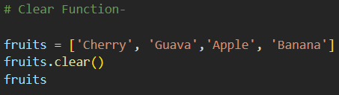
Built-in function for List
These are python functions that are used directly on list for specific output. Below are some important functions
Try it yourself
count( )–Returns the number of items with the specified value.
index( )–Returns the index of the first element with the specified value
copy( )– Returns a copy of the list
clear( ) – Removes all the items from the list
pop() -Removes the items at the specified position

Slide 19
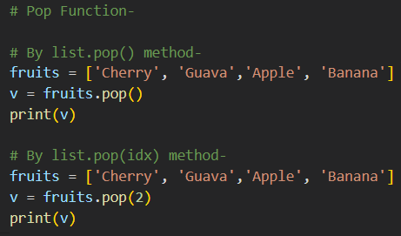
Built-in function for List
These are python functions that are used directly on list for specific output. Below are some important functions
Try it yourself
pop() -Removes the items at the specified position
Pop can be used in two ways:-
list.pop() - Remove the last value in the list and gives us that value.
list.pop(idx)- Remove the value from index if idx is valid and gives the value.

Slide 20
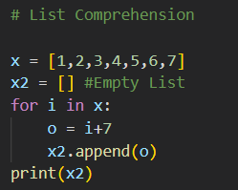
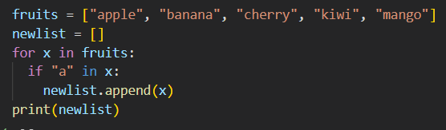

List comprehension
comprehension
List comprehension offers a shorter syntax when you want to create a new list based on the values of an existing list.

Slide 21
THE END

